Slide 1

Welcome to Spring 3.0

Slide 2
Chapter 0 : Spring Background
1
2
Why Do We Need Spring
3
Spring Course Content
Web Timeline
4
5
Design Patterns Used In Spring
Setup And Hello World

Slide 3
1
Web Timeline Primitive ways of designing web apps and evolution

Slide 4
Internet Timeline
OPEN TO PUBLIC
aa
Birth at UCLA
29-10-69
TCP/IP adopted as Internet Std
.com
Rise of J2EE
aa
WWW
ISPs
DNS
Biggest growth
aa
aa
aa
Email
Rise of Mobile Web
PCs TCP/IP
69
72
73
77
83
84
89
91
93
95
07
70
Win 95
80
90
00
05
11
aa
TCP
IP (TCP/IPv3)
.gov
.edu
.mil
.org
.net
aa
Browser
(Mosiac)
IPV6
(Internet2)
Browser war
ARPANET
Number of computers connected (users)
100M websites
4
23
100
200
1k
10k
100k
1M
18M
800M
1B
3B?
56k
1.5M
45M
622M
2.5G
10G
38G
DSO
T-1
T-3
OC-12
OC-48
OC-192
OC-768
Telecommunication bandwidth/speed(bps)

Slide 5
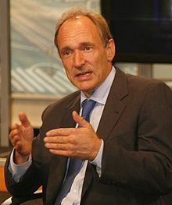
First “Website”
http://info.cern.ch/hypertext/WWW/TheProject.html
http://www.w3.org/History/19921103-hypertext/hypertext/WWW/TheProject.html
1990 : - WWW inventor Tim Berners-Lee in CERN wrote two programs
Browser for HTML
Web server using HTML and HTTP(GET).
XSL
XSLT
XML
XSD
IBM GML
SGML
HTML
HTML5
DTD
Scripts
CSS
XHTML

Slide 6
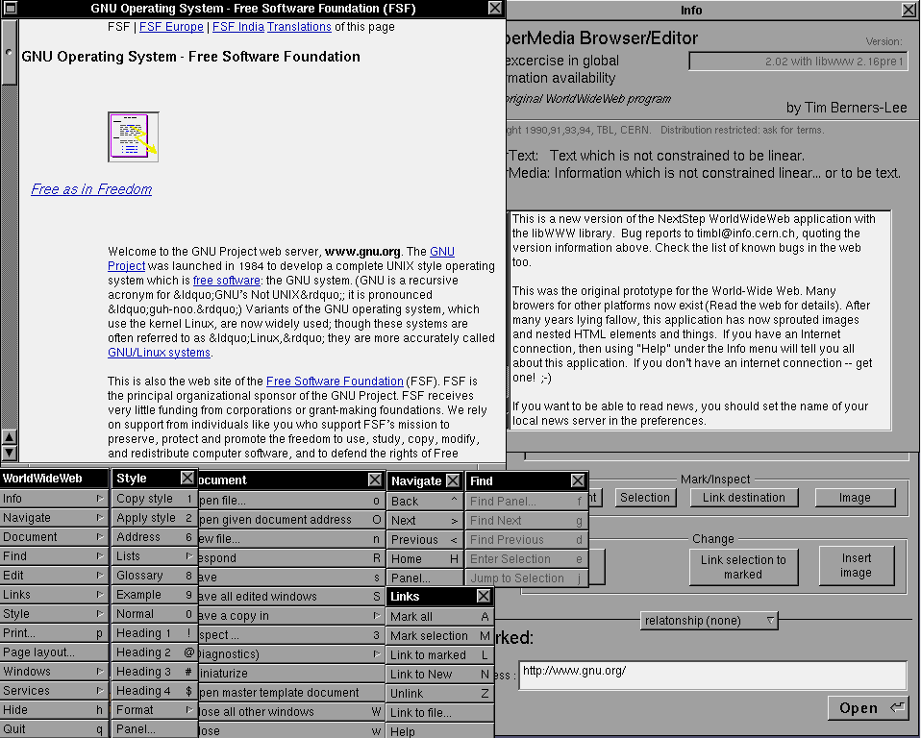
(It was called WorldWideWeb and was later renamed Nexus)
First Browser

Slide 7
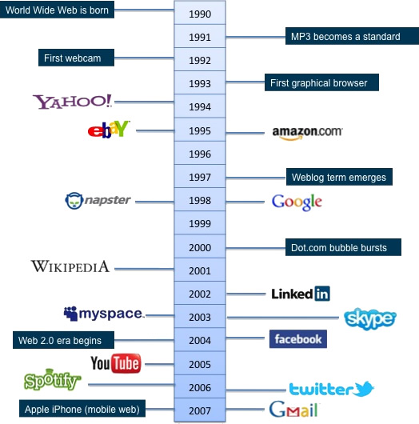
Notes:
Computers -> Number crunchers to social, economic and knowledge platform

Slide 8
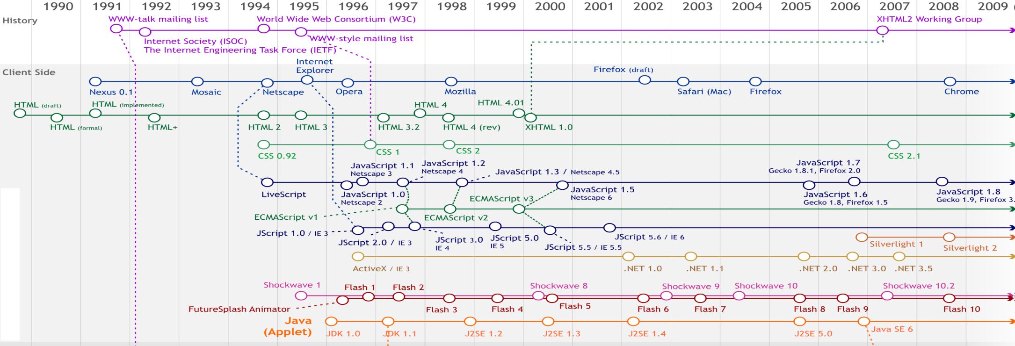
Client Side
Client-side refers to operations that are performed by the client(typically a web browser, that runs on a user's local computer) in a client-server relationship in a computer network.

Slide 9
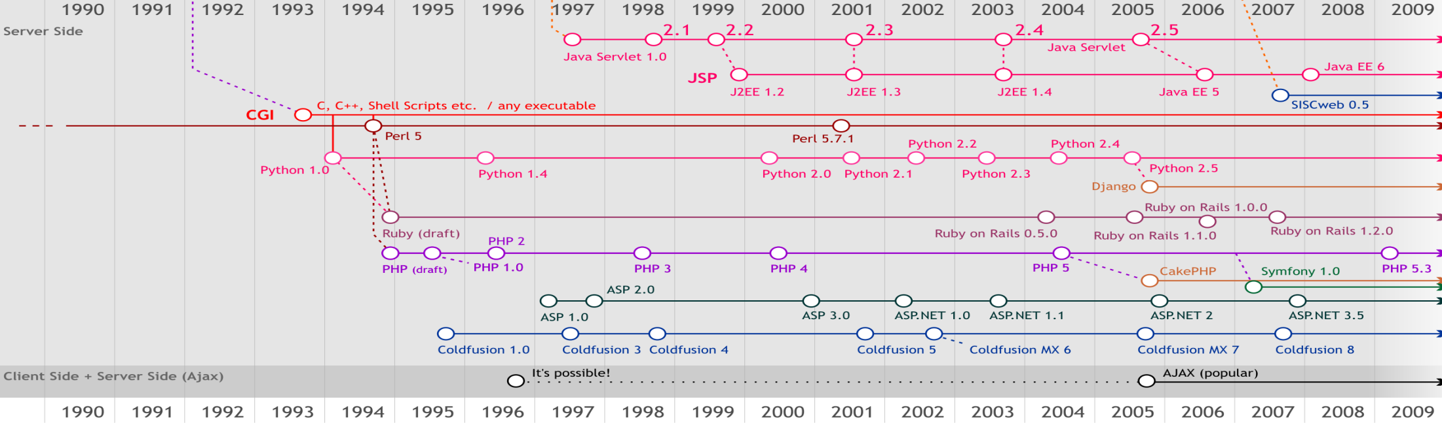
Server Side
Server-side refers to operations that are performed by the server in a client-server relationship in computer networking

Slide 10
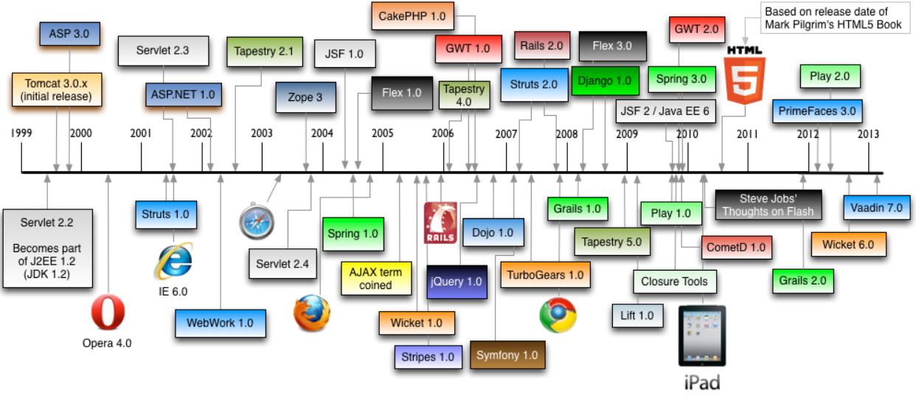
Web Framework Timeline

Slide 11
Spring framework timeline
Spring framework released under apache 2.0 in June
Spring 2.0 released in October
Spring 3.0 released in December
The current version is 3.2.3, which was released in May
2003
2004
2005
2006
2007
2008
2009
2010
2011
2012
2013
First milestone 1.0 released in March 04, Sep 04 &march 05
Spring 2.5 released in November
Spring 3.1 released in December
won a Jolt productivity and a JAX Innovation Award

Slide 12
Why do we need Spring [HTML => CGI(Perl etc.) => servlets => jsp => MVC 1 &2 => Struts => Spring]
2

Slide 13
HTML
CGI(e.g. with Perl)
Servlets
JSP
Code Samples
MVC 1 &2 (Servlet+JSP)
Struts
Spring

Slide 14
Code Sample Story Board
Secure Area
Logon
Database
User Accounts
Bank Customer
User Cards
User Loans
Bank Prospect
Public Area
Accounts Offers
Cards Offers
Loans Offers

Slide 15
HTML
HTML is OK for static documents/pages, but lousy for programs and data handling hence we need better technology which can run on server side and interact with db.
Why Build Web Pages Dynamically?
The Web page is based on data submitted by the user
E.g., results page from search engines and order confirmation pages at on-line stores
The Web page is derived from data that changes frequently
E.g., a weather report or news headlines page
The Web page uses information from databases or other server-side sources
E.g., an e-commerce site could use a servlet to build a Web page that lists the current price and availability of each item that is for sale.

Slide 16
The Advantages of Servlets
Over “Traditional” CGI
Efficient
Threads instead of OS processes, one servlet copy
Convenient
Lots of high-level utilities
Powerful
Sharing data, pooling, persistence
Portable
Run on virtually all operating systems and servers
Inexpensive
There are plenty of free and low-cost servers
Secure
No shell escapes, no buffer overflows
Popular
Java is by far the leader in the market
Notes:
Java is a bit more robust & popular, CGI with Perl better for glue(fork+execute), PHP3 for ease of use and rapid development
Servlets are run in one process (HTTP server with additional features, which called Servlet Container) and they exist as long as that process exists.
CGI means every time there's client request, HTTP server creates new instance of process to serve this request. This is performance killer. Additionally, since there's new process per each request, it means CGI can't aggregate data from several requests in memory, as Servlets can, and must resort to external persistent storage (file or DB). This is performance killer as well.

Slide 17
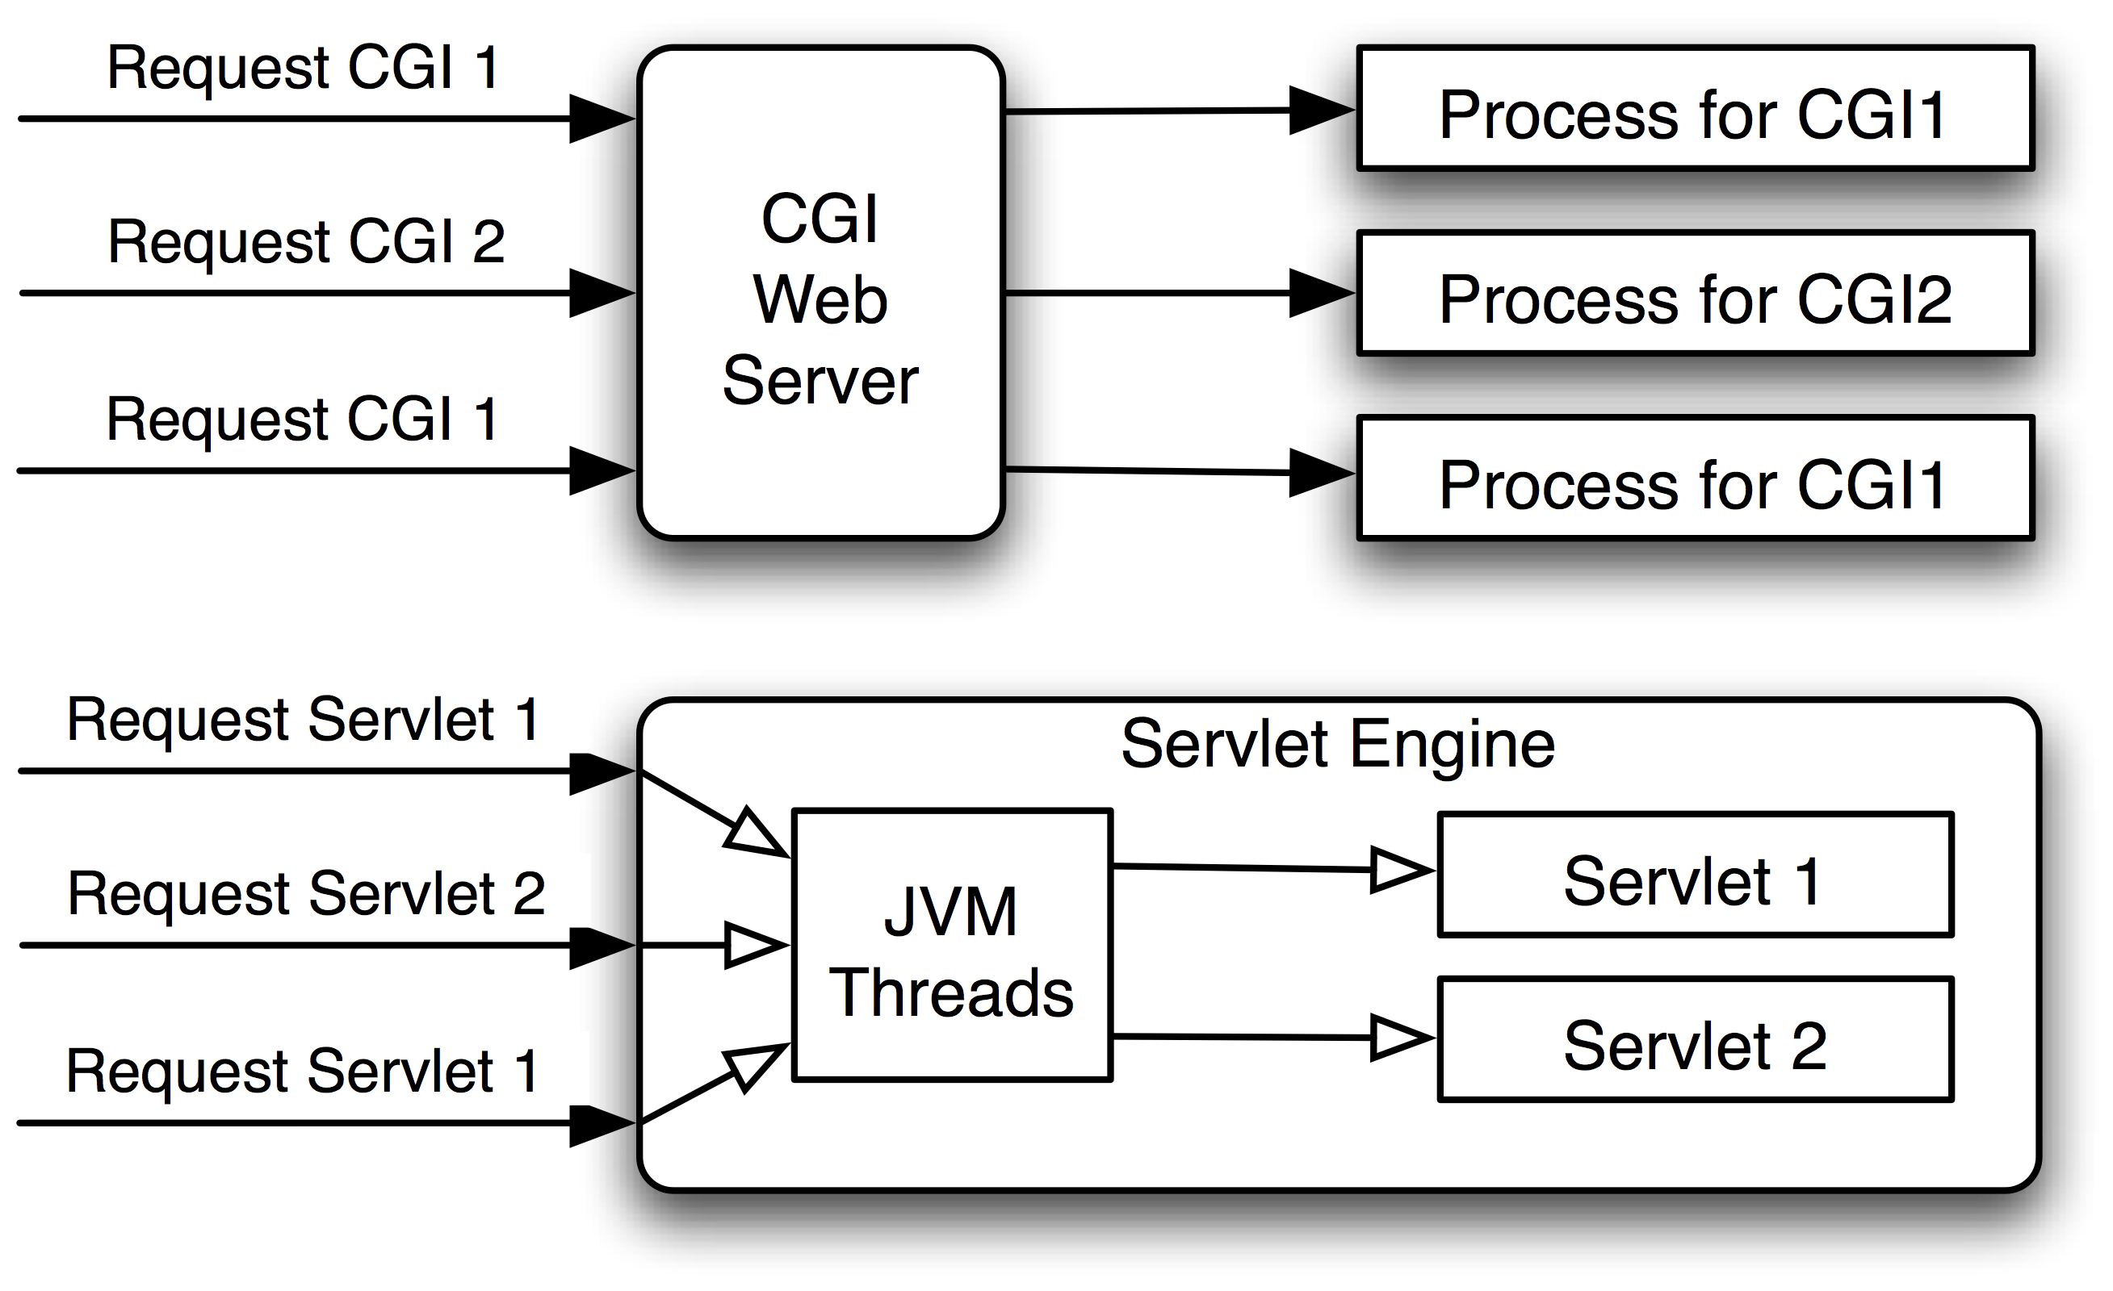
The Advantages of Servlets
Over “Traditional” CGI

Slide 18
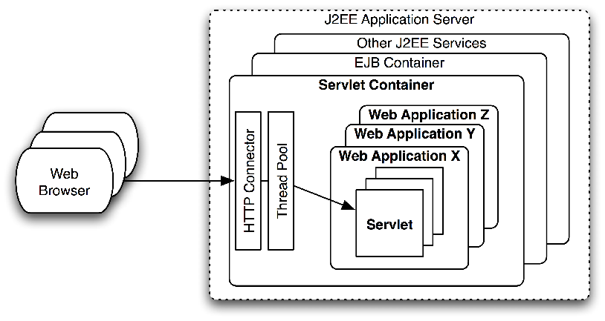
Servlet Container
Notes:
Servlet lifecycle
A Web server is a program that, using the client/server model and the World Wide Web's Hypertext Transfer Protocol ( HTTP ), serves the files that form Web pages to Web users (whose computers contain HTTP clients that forward their requests). Every computer on the Internet that contains a Web site must have a Web server program.

Slide 19
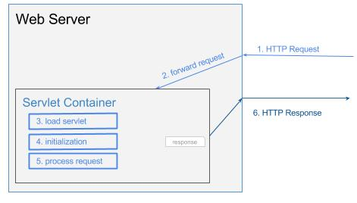
Web Server
Notes:
Web server receives HTTP request
Web server forwards the request to servlet container
The servlet is dynamically retrieved and loaded into the address space of the container, if it is not in the container.
The container invokes the init() method of the servlet for initialization(invoked once when the servlet is loaded first time)
The container invokes the service() method of the servlet to process the HTTP request, i.e., read data in the request and formulate a response. The servlet remains in the container’s address space and can process other HTTP requests.
Web server return the dynamically generated results to the correct location

Slide 20
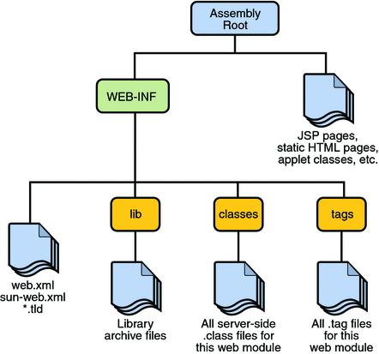
Web Application(.war)

Slide 21
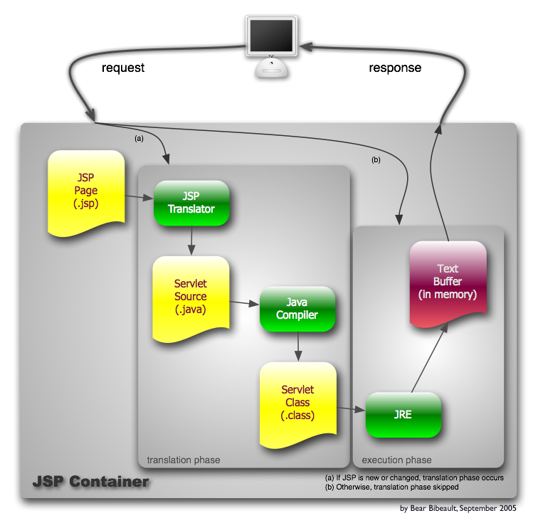
JSP Container
Notes:
There is no such thing as a JSP container which is not a Servlet container because a JSP is translated into Servlet before it is executed. So a JSP container must support Servlet.
The opposite is not always true, at least in the old times when Servlet technology first came into existence and the container was called Servlet container

Slide 22
Servlet vs. JSP
Servlet | JSP
Servlet is html in java. Servlet uses pure java code. | JSP is java in html. JSP pages contain a mixture of HTML, Java scripts, JSP elements, and JSP directives
Servlets are Java programs that are already compiled which also creates dynamic web content. | JSP is a webpage scripting language that can generate dynamic content.
Servlets run faster compared to JSP. | JSP engine translates JSP in servlet on 1st request, compiles it and saves byte code format in JSP Container. (JSP is a special kind of Servlet)
Servlets are best for use when there is more processing and manipulation involved. | JSP are generally preferred when there is not much processing of data required.
Servlets are more suited for back-end developers because they are often written using an IDE -- a process that generally requires a higher level of programming expertise | JSP helps effectively separating presentation(look & feel) from content(data).Web Page designers can easily write a JSP page using conventional HTML or XML tools.

Slide 23
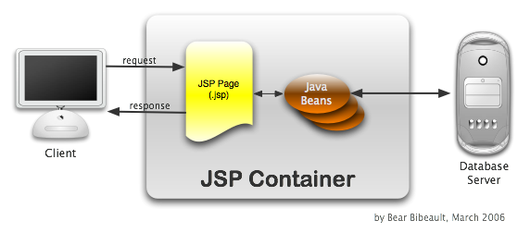
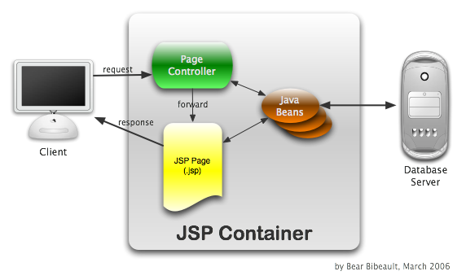
MVC1 vs. MVC2
Model(Java code) | The business or database code
View(JSP) | The page design code
Controller(Servlet) | The navigational code
Notes:
Java is perhaps a bit more robust, CGI with Perl better for glue(fork+execute), PHP3 for ease of use and rapid development
Servlets are run in one process (HTTP server with additional features, which called Servlet Container) and they exist as long as that process exists.
CGI means every time there's client request, HTTP server creates new instance of process to serve this request. This is performance killer. Additionally, since there's new process per each request, it means CGI can't aggregate data from several requests in memory, as Servlets can, and must resort to external persistent storage (file or DB). This is performance killer as well.

Slide 24
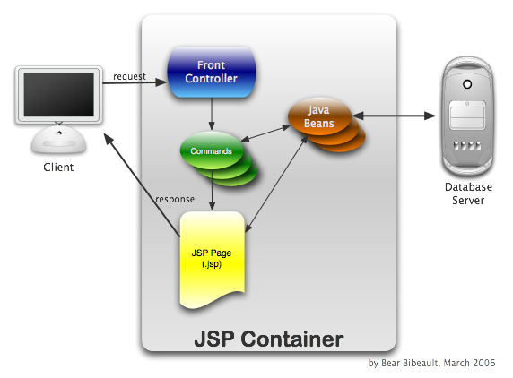
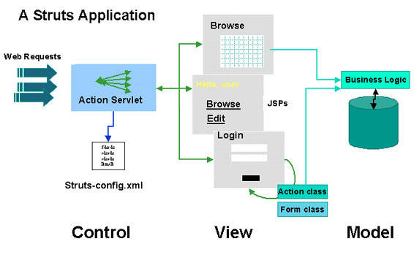
Struts flow

Slide 25
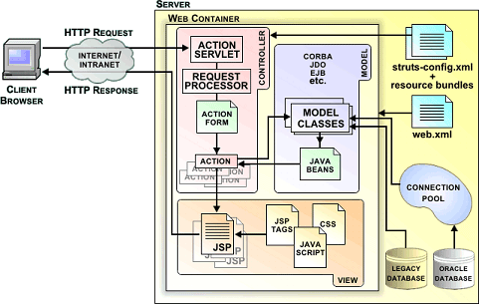
Struts

Slide 26
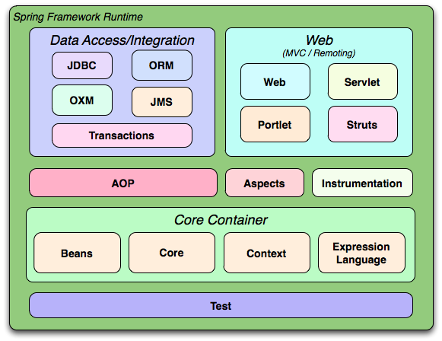
Spring

Slide 27
3
Spring course content

Slide 28
Chapter 0 – Spring Background
Web Timeline
Why do we need Spring?
Spring Course Content
Setup and Hello World
Design Patterns used in Spring

Slide 29
Chapter 1 – Spring Core
Inversion of Control /Dependency Injection (IoC/DI)
Part A | IOC Container (BeanFactory / ApplicationContext)
 | Managed Beans
 | Bean Lifecycle
Part B | XML Based DI
 | Annotation Based DI
 | Java Based DI
Resources
Validators and Convertors
Spring Expression Language (SpEL)

Slide 30
Chapter 2 – AOP
Aspect Oriented Programming (AOP) | Structured vs. OOP vs. AOP
 | AOP Weaving
 | AOP Proxy
 | AOP Terminologies
 | Types of Advices
 | Code samples

Slide 31
Chapter 3 – Web Tier
Spring MVC | Architecture DispatcherServlet
 | Request/Response Lifecycle Spring MVC Details
 | Handler Mappings Controllers View Resolvers
 | Tags Validation Message Bundle
 | Integration of Spring with Struts
 | Mini Project

Slide 32
Chapter 4 – Data Tier
The Service Layer(data tier) | DataAccess with JDBC
 | Transaction Management
 | Integrating Spring with JPA
 | Integrating Spring with JDO
 | Marshalling XML using O/X Mappers
 | Integrating Spring with Hibernate
 | Mini Project

Slide 33
Chapter 5 – Spring Security
Spring Security | What is Spring Security?
 | Acquiring and Integrating Spring Security
 | HTTP BASIC authentication(Form and Basic Login/logout options)
 | Authorisation
 | Security Interceptor, Filters
 | Authentication Manager & provider, Authorization Manager & provider
 | Advance concepts and integration

Slide 34
Chapter 6 – Adv topics
Advance topics | Remoting & Web services
 | JMS
 | I18N
 | REST

Slide 35
4
Setup and First Look at Spring Sample Code

Slide 36
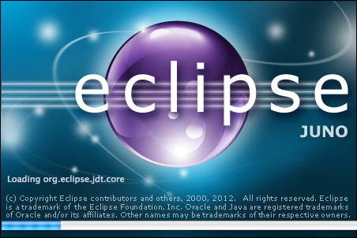
Eclipse Download
http://www.eclipse.org/downloads/packages/eclipse-ide-java-ee-developers/junosr1
http://www.eclipse.org/downloads/download.php?file=/technology/epp/downloads/release/juno/SR1/eclipse-jee-juno-SR1-win32-x86_64.zip

Slide 37

Download
http://tomcat.apache.org/download-60.cgi
http://download.nextag.com/apache/tomcat/tomcat-6/v6.0.37/bin/apache-tomcat-6.0.37.zip

Slide 38

Download
http://www.springsource.org/download/community
http://s3.amazonaws.com/dist.springframework.org/release/SPR/spring-framework-3.0.1.RELEASE.zip
http://s3.amazonaws.com/dist.springframework.org/release/SPR/spring-framework-3.0.1.RELEASE-dependencies.zip

Slide 39

Spring Tool Suite Download
http://www.springsource.org/downloads/sts-ggts

Slide 40
5
Design patterns used in Spring
The Spring Framework codifies formalized design patterns as first-class objects that you can integrate into your own application
Notes:
Spring Design Patterns
1. MVC - The advantage with Spring MVC is that your controllers are POJOs as opposed to being servlets. This makes for easier testing of controllers.
2. Front controller - Spring provides "DispatcherServlet" to ensure an incoming request gets dispatched to your controllers.
3. View Helper - Spring has a number of custom JSP tags, and velocity macros, to assist in separating code from presentation in views.
4. Singleton - Beans defined in spring config files are singletons by default.
5. Prototype - Instance type can be prototype.
6. Factory - Used for loading beans through BeanFactory and Application context.
7. Builder - Spring provides programmatic means of constructing BeanDefinitions using the builder pattern through Class "BeanDefinitionBuilder".
8. Template - Used extensively to deal with boilerplate repeated code (such as closing connections cleanly, etc...). For example JdbcTemplate.
9. Proxy - Used in AOP & Remoting.
10. DI/IOC - It is central to the whole BeanFactory/ApplicationContext stuff.

Slide 41
Spring Design Patterns
1. MVC - The advantage with Spring MVC is that your controllers are POJOs as opposed to being servlets. This makes for easier testing of controllers.
2. Front controller - Spring provides "DispatcherServlet" to ensure an incoming request gets dispatched to your controllers.
3. View Helper - Spring has a number of custom JSP tags, and velocity macros, to assist in separating code from presentation in views.
4. Singleton - Beans defined in spring config files are singletons by default.
5. Prototype - Instance type can be prototype.
6. Factory - Used for loading beans through BeanFactory and Application context.
7. Builder - Spring provides programmatic means of constructing BeanDefinitions using the builder pattern through Class "BeanDefinitionBuilder".
8. Template - Used extensively to deal with boilerplate repeated code (such as closing connections cleanly, etc...). For example JdbcTemplate.
9. Proxy - Used in AOP & Remoting.

Slide 42

Spring Course Content

